Slide 1
Firmware Kernel Fuzzing
Lingyun Situ
2018-3-23

Slide 2
Outline
Kernel Fuzzing challenges
Existing kernel fuzzing tools
When kernel fuzzing meets firmware
kAFL[CCS’17], Corruption is not crash[NDSS’18]
Our firmware
Problems of applying kAFL to firmware

Slide 3
Kernel fuzzing challenges
Kernel code has more non-determinism
Statefulness, multiple kernel threads, interrupt, .etc
No equivalent interface to interact with kernel
Like cmd, stdin, .etc
Many relevant drivers and components are closed source.
Hard to be instrumented without significant performance overhead

Slide 4
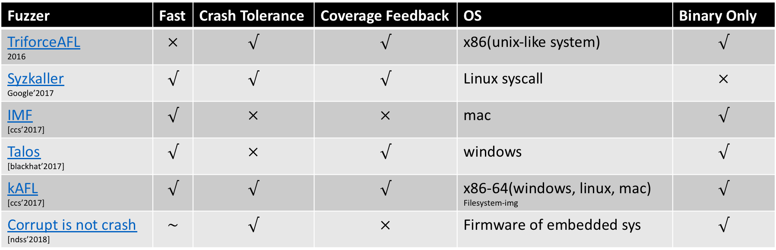
Existing kernel fuzzing
Fuzzer | Fast | Crash Tolerance | Coverage Feedback | OS | Binary Only
TriforceAFL 2016 | $$×$$ | $$√$$ | $$√$$ | x86(unix-like system) | $$√$$
Syzkaller Google’2017 | $$√$$ | $$√$$ | $$√$$ | Linux syscall | $$×$$
IMF [ccs’2017] | $$√$$ | $$×$$ | $$×$$ | mac | $$√$$
Talos [blackhat’2017] | $$√$$ | $$×$$ | $$√$$ | windows | $$√$$
kAFL [ccs’2017] | $$√$$ | $$√$$ | $$√$$ | x86-64(windows, linux, mac) Filesystem-img | $$√$$
Corrupt is not crash [ndss’2018] | $$\sim$$ | $$√$$ | $$×$$ | Firmware of embedded sys | $$√$$

Slide 5
When kernel fuzzing meets Firmware
More silent memory corruption for lacking mechanism to detect fault
Fault detection is hard to monitor lack of MMU, .etc
Observable crash, Reboot, Hang, Late crash, Malfunctioning, No effect, .etc
Different instruments set and CPU architecture
Hard to instrument, collect feedback
Operation tied to OS-specific features
Different firmware has different operations and functionalities
Notes:
Memory management unit
Heap consistency checks
canaries

Slide 6
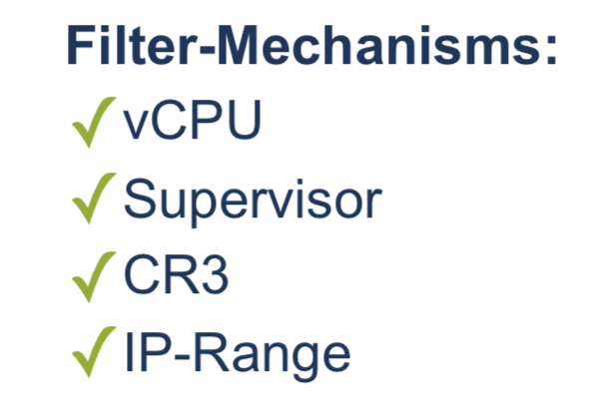
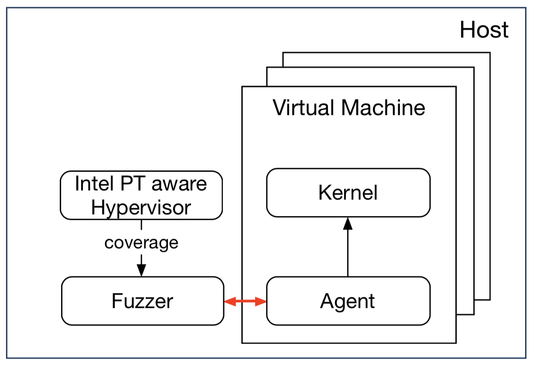
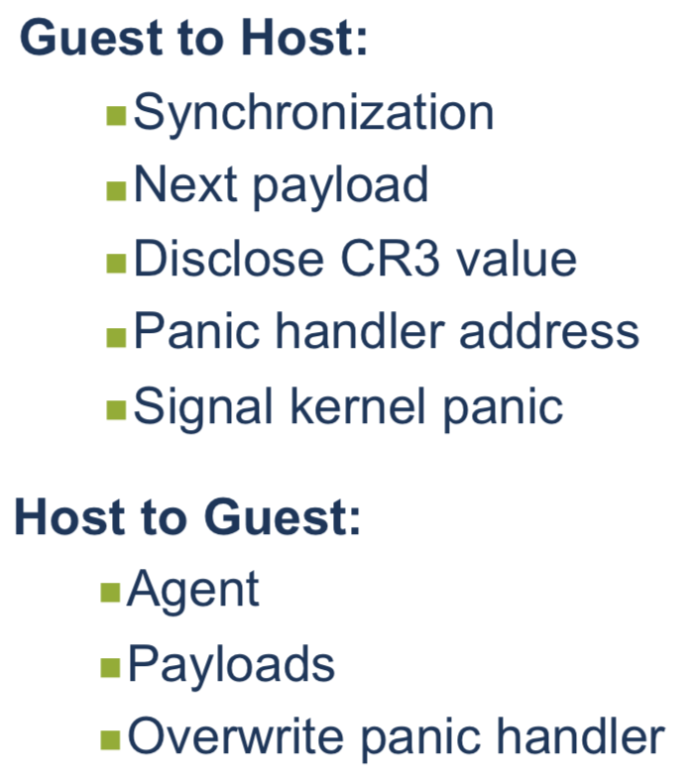
kAFL [CCS’17]

Slide 7
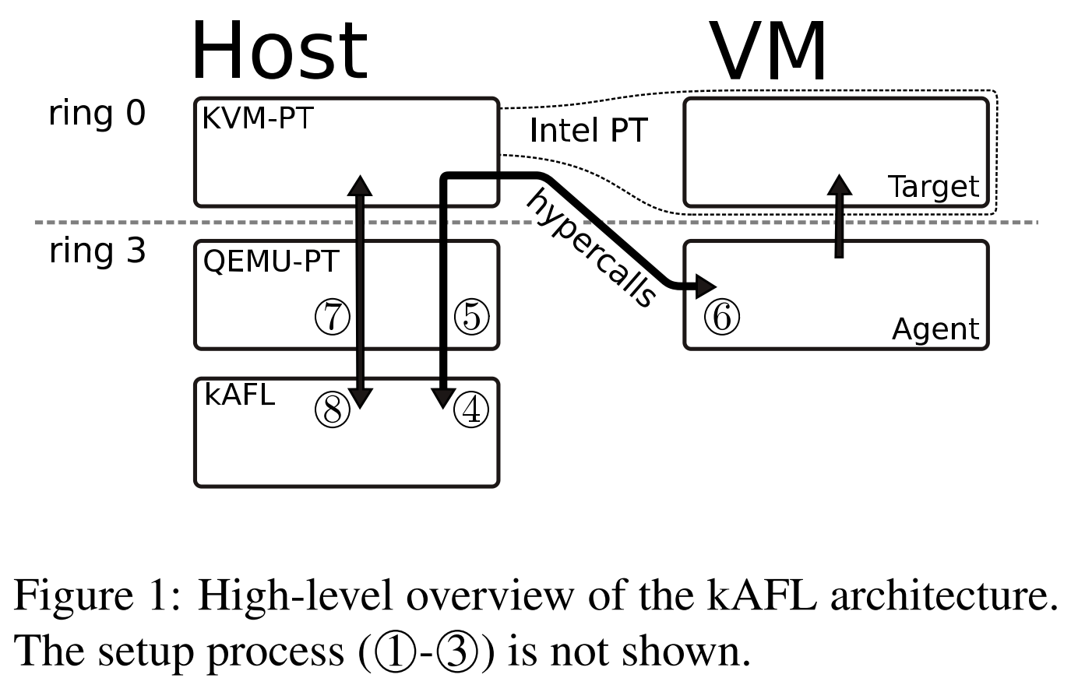
kAFL [CCS’17]
Agent(loader) use HC_SUBMIT_PANIC to submit the address of kernel panic handler to QEMU-PT, the loader user HC_GET_PROGRAM to start the user mode agent.
Agent triggers HC_SUBMIT, which extracts the CR3 value of the currently running process, and hands it over to QEMU-PT for filtering.
Agent uses HC_SUBMIT_BUFFER to inform the host at which address it expects input, and request a input using HC_GET_INPUT.

Slide 8
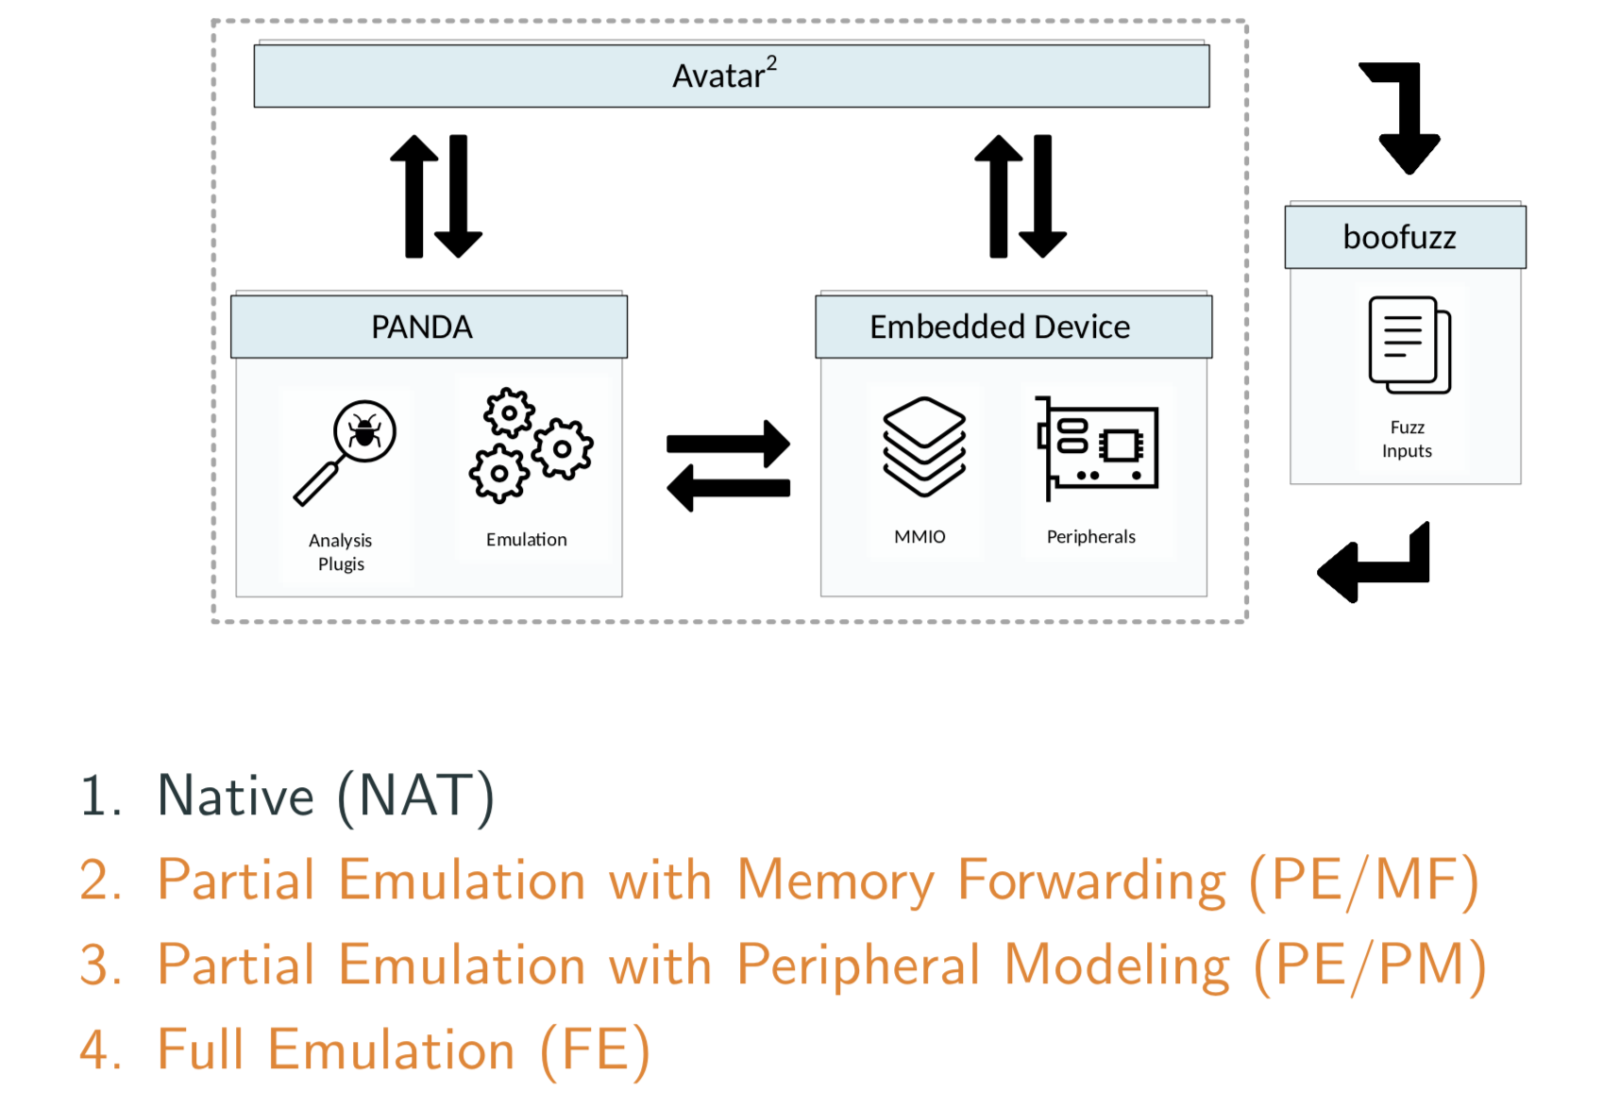
Corruption is not Crash[NDSS’18]
In all tests, the inputs to the vulnerable software are provided on a simple textual protocol which is communicated over a serial connection.
While full emulation is the best strategy, emulators are rarely available.
Partial emulation can lead to accurate vulnerability detection, with a significant performance impact.

Slide 9
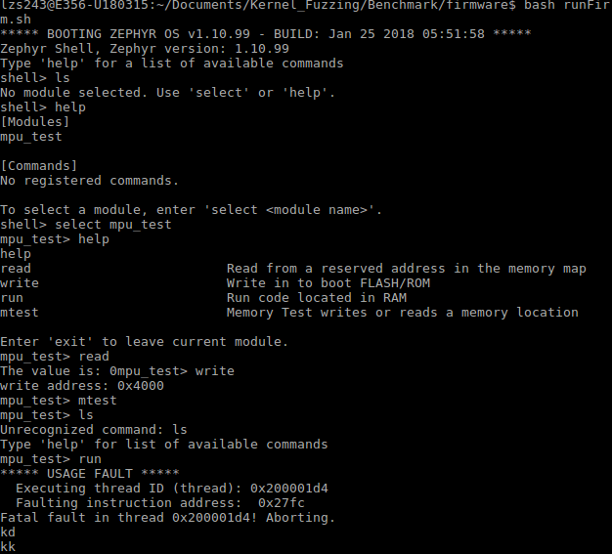
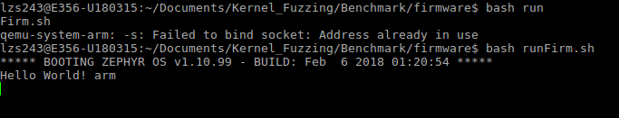
Our firmware
Unknown interface
Different interface
No input interface ?
Shell command

Slide 10
Problems of Appling kAFL to firmware
What’s the influence of non-x86 architecture of firmware ?
Does Hypercall still work ? (Yes)
What do we need to modify ?
Agent, KVM-PT, QEMU-PT
How to write the agent for different firmware ?
Unknown interface, different interface
How to handle the silent memory corruption ?
Lack of MMU, heap consistency check,…

Slide 11
Todo next:
Architecture cortex M
Understanding the knowledge
Specific firmware kernel code
Mpu_test
Analysis the event (focus the specify common event in firmware)
See the code of KVM
We will need to modify the KVM-PT, QEMU-PT, and Agent
Try to write a tool
Prof.Liu: Discuss more with Prof.Liu to learn his way of thinking

Slide 12
Firmware Kernel Fuzzing
Lingyun Situ
2018-04-12

Slide 13
Outline
ARM and Cortex-M3
Fault exception
Interfaces
Specific firmware code
Mpu_test
Intel-PT
Other dynamic symbolic execution tools for arm binary
S2E
Angr
Avatar2
Todo next

Slide 14
List of ARM architecture
Architecture | Core bit-width | Cores |  | Profile
 |  | ARM Holdings | Third-party
ARMv1 | 32^{[a 1]} | ARM1 |  | Classic
ARMv2 | 32^{[a 1]} | ARM2, ARM250, ARM3 | Amber, STORM Open Soft Core^{[39]} | Classic
ARMv3 | 32^{[a 2]} | ARM6, ARM7 |  | Classic
ARMv4 | 32^{[a 2]} | ARM8 | StrongARM, FA526, ZAP Open Source Processor Core^{[40]} | Classic
ARMv4T | 32^{[a 2]} | ARM7TDMI, ARM9TDMI, SecurCore SC100 |  | Classic
ARMv5TE | 32 | ARM7EJ, ARM9E, ARM10E | XScale, FA626TE, Feroceon, PJ1/Mohawk | Classic
ARMv6 | 32 | ARM11 |  | Classic
ARMv6-M | 32 | ARM Cortex-M0, ARM Cortex-M0+, ARM Cortex-M1, SecurCore SC000 |  | Microcontroller
ARMv7-A | 32 | ARM Cortex-A5, ARM Cortex-A7, ARM Cortex-A8, ARM Cortex-A9, ARM Cortex-A12,ARM Cortex-A15, ARM Cortex-A17 | Qualcomm Krait, Scorpion, PJ4/Sheeva, Apple Swift | Application
ARMv7-M | 32 | ARM Cortex-M3, SecurCore SC300 |  | Microcontroller
ARMv7-R | 32 | ARM Cortex-R4, ARM Cortex-R5, ARM Cortex-R7, ARM Cortex-R8 |  | Real-time
ARMv7E-M | 32 | ARM Cortex-M4, ARM Cortex-M7 |  | Microcontroller
ARMv8-A | 64/32 | ARM Cortex-A35,^{[47]} ARM Cortex-A53, ARM Cortex-A57,^{[48]} ARM Cortex-A72,^{[49]}ARM Cortex-A73^{[50]} | X-Gene, Nvidia Project Denver, CaviumThunder X^{[51][52][53]}, AMD K12, Apple Cyclone/Typhoon/Twister/Hurricane/Zephyr, Qualcomm Kryo, Samsung M1 and M2 ("Mongoose")^{[54]} | Application
ARMv8-A | 32 | ARM Cortex-A32 |  | Application
ARMv8-M | 32 | ARM Cortex-M23,^{[41]} ARM Cortex-M33^{[42]} |  | Microcontroller
ARMv8-R | 32 | ARM Cortex-R52 |  | Real-time
ARMv8.1-A | 64/32 | TBA |  | Application
ARMv8.2-A | 64/32 | ARM Cortex-A55,^{[57]} ARM Cortex-A75,^{[58]} |  | Application
ARMv8.3-A | 64/32 | TBA |  | Application
ARMv8.4-A | 64/32 | TBA |  | Application

Slide 15
ARMv7 architecture
Year | Classic cores |  |  |  |  | Cortex cores
 | ARM7 | ARM8 | ARM9 | ARM10 | ARM11 | Microcontroller | Real-time | Application (32-bit) | Application (64-bit)
1993 | ARM700
1994 | ARM710 ARM7DI ARM7TDMI
1995 | ARM710a
1996 |  | ARM810
1997 | ARM710T ARM720T ARM740T
1998 |  |  | ARM9TDMI ARM940T
1999 |  |  | ARM9E-S ARM966E-S
2000 |  |  | ARM920T ARM922T ARM946E-S | ARM1020T
2001 | ARM7TDMI-S ARM7EJ-S |  | ARM9EJ-S ARM926EJ-S | ARM1020E ARM1022E
2002 |  |  |  | ARM1026EJ-S | ARM1136J(F)-S
2003 |  |  | ARM968E-S |  | ARM1156T2(F)-S ARM1176JZ(F)-S
2004 |  |  |  |  |  | Cortex-M3
2005 |  |  |  |  | ARM11MPCore |  |  | Cortex-A8
2006 |  |  | ARM996HS
2007 |  |  |  |  |  | Cortex-M1 |  | Cortex-A9
2008
2009 |  |  |  |  |  | Cortex-M0 |  | Cortex-A5
2010 |  |  |  |  |  | Cortex-M4(F) |  | Cortex-A15
2011 |  |  |  |  |  |  | Cortex-R4 Cortex-R5 Cortex-R7 | Cortex-A7
2012 |  |  |  |  |  | Cortex-M0+ |  |  | Cortex-A53 Cortex-A57
2013 |  |  |  |  |  |  |  | Cortex-A12
2014 |  |  |  |  |  | Cortex-M7(F) |  | Cortex-A17
2015 |  |  |  |  |  |  |  |  | Cortex-A35 Cortex-A72
2016 |  |  |  |  |  | Cortex-M23 Cortex-M33(F) | Cortex-R8 Cortex-R52 | Cortex-A32 | Cortex-A73
2017 |  |  |  |  |  |  |  |  | Cortex-A55 Cortex-A75
ARMv7-A
The application profile for systems supporting the ARM and Thumb instruction sets, and requiring virtual address support in the memory management model.
ARMv7-R
The realtime profile for systems supporting the ARM and Thumb instruction sets, and requiring physical address only support in the memory management model.
ARMv7-M
The microcontroller profile for systems supporting only the Thumb instruction set, and where overall size and deterministic operation for an implementation are more important than absolute performance.
https://en.wikipedia.org/wiki/List_of_ARM_microarchitectures
ARM core timeline

Slide 16
Cortex-M
ARM family | ARM architecture | ARM core | Feature | Cache (I / D), MMU | Typical MIPS @ MHz
Cortex-M | ARMv6-M | Cortex-M0[12] | Microcontroller profile, most Thumb + some Thumb-2,[13] hardware multiply instruction (optional small), optional system timer, optional bit-banding memory | Optional cache, no TCM, no MPU | 0.84 DMIPS/MHz
 |  | Cortex-M0+^{[14]} | Microcontroller profile, most Thumb + some Thumb-2,^{[13]} hardware multiply instruction (optional small), optional system timer, optional bit-banding memory | Optional cache, no TCM, optional MPU with 8 regions | 0.93 DMIPS/MHz
 |  | Cortex-M1^{[15]} | Microcontroller profile, most Thumb + some Thumb-2,^{[13]} hardware multiply instruction (optional small), OS option adds SVC / banked stack pointer, optional system timer, no bit-banding memory | Optional cache, 0–1024 KB I-TCM, 0–1024 KB D-TCM, no MPU | 136 DMIPS @ 170 MHz,^{[16]}(0.8 DMIPS/MHz FPGA-dependent)^{[17]}
 | ARMv7-M | Cortex-M3^{[18]} | Microcontroller profile, Thumb / Thumb-2, hardware multiply and divide instructions, optional bit-banding memory | Optional cache, no TCM, optional MPU with 8 regions | 1.25 DMIPS/MHz
 | ARMv7E-M | Cortex-M4^{[19]} | Microcontroller profile, Thumb / Thumb-2 / DSP / optional VFPv4-SP single-precision FPU, hardware multiply and divide instructions, optional bit-banding memory | Optional cache, no TCM, optional MPU with 8 regions | 1.25 DMIPS/MHz (1.27 w/FPU)
 |  | Cortex-M7^{[20]} | Microcontroller profile, Thumb / Thumb-2 / DSP / optional VFPv5 single and double precision FPU, hardware multiply and divide instructions | 0−64 KB I-cache, 0−64 KB D-cache, 0–16 MB I-TCM, 0–16 MB D-TCM (all these w/optional ECC), optional MPU with 8 or 16 regions | 2.14 DMIPS/MHz

Slide 17
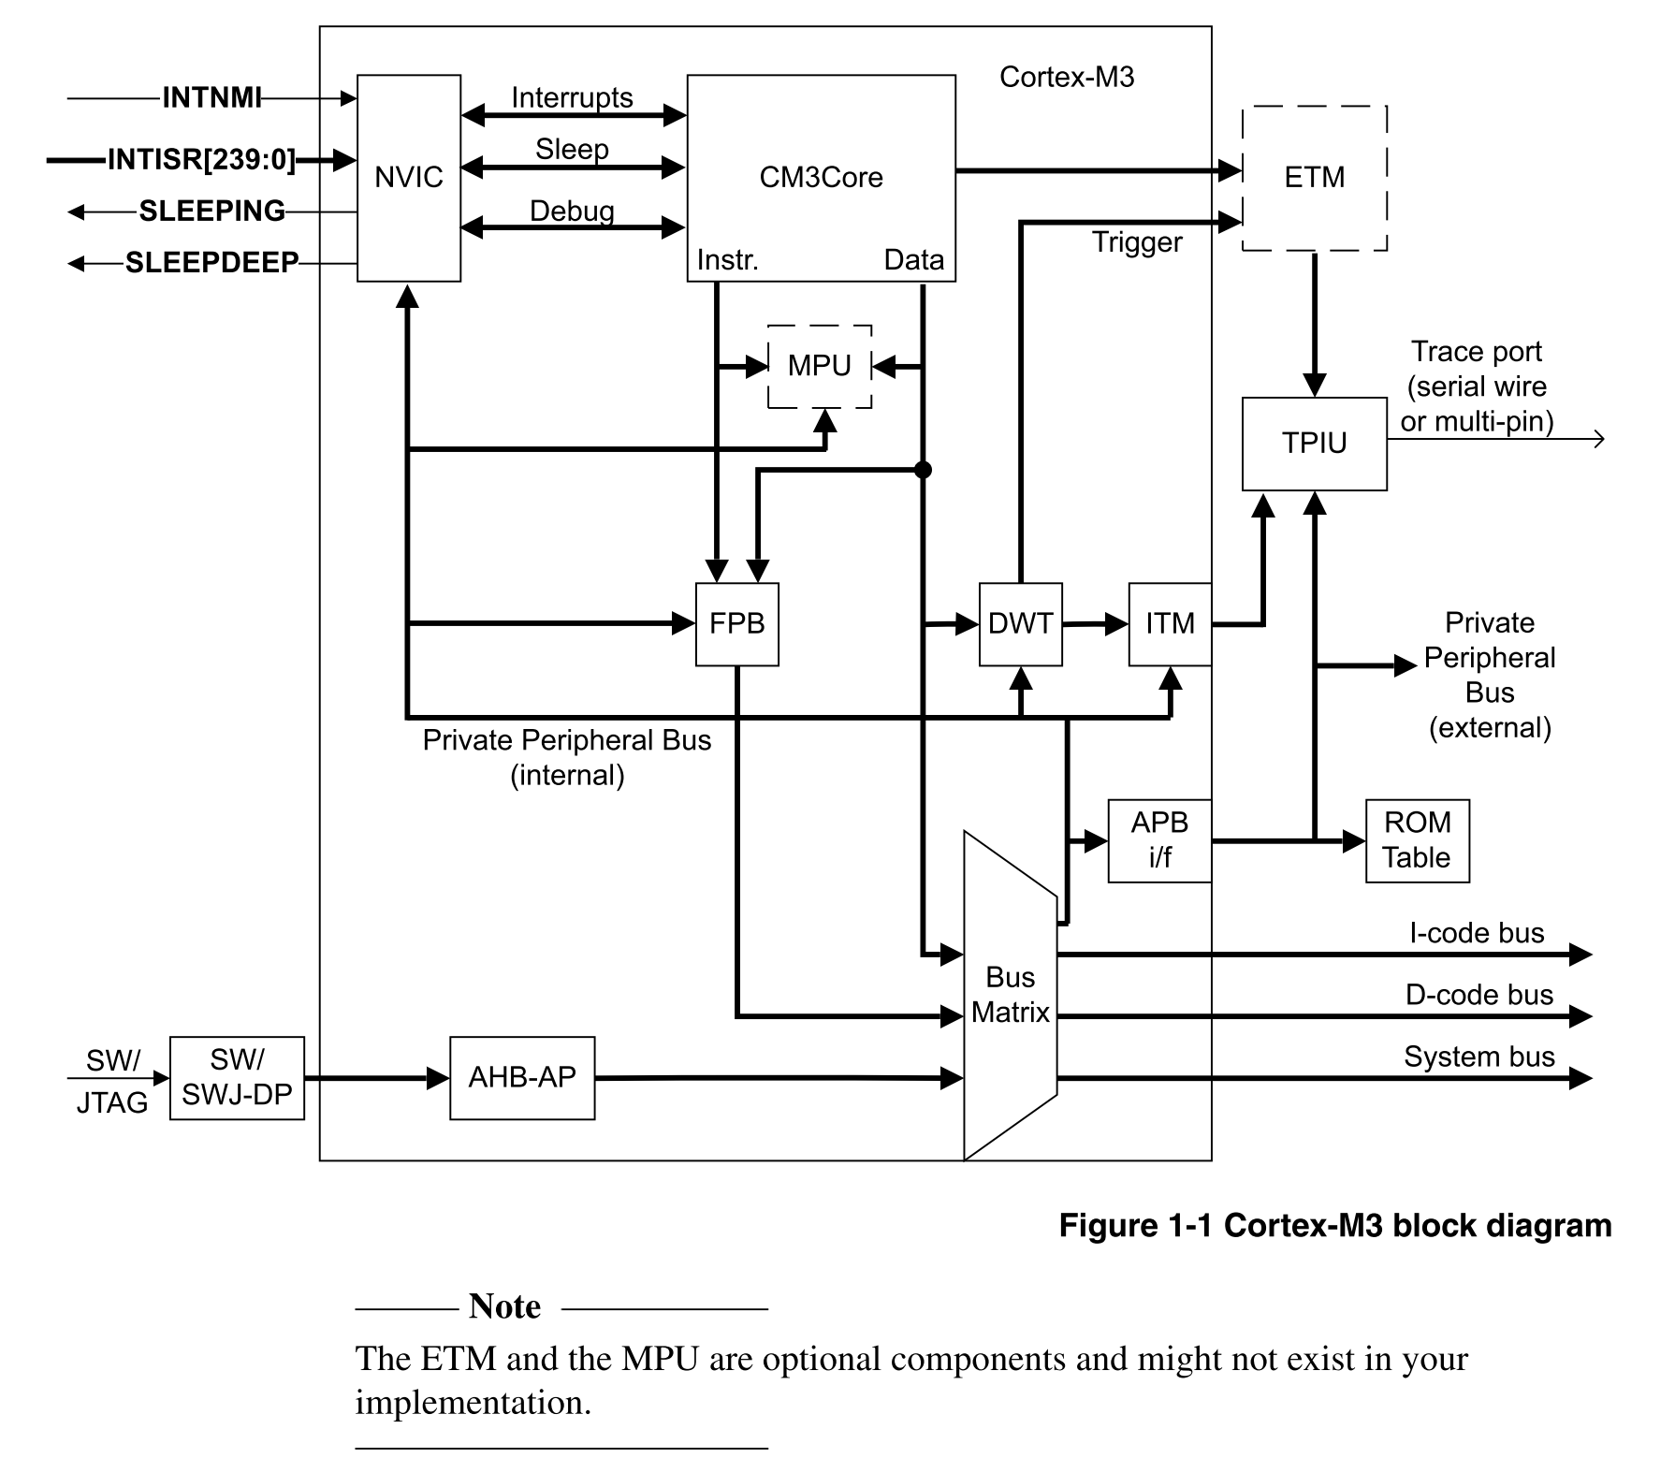
Cortex-M3
The processor is a low-power processor that features low gate count, low interrupt latency, and low-cost debug. It is intended for deeply embedded applications that require fast interrupt response features.
The processor incorporates:
ARMv7-M.
Thumb®2 Instruction Set.
Handler and Thread modes.
An optional MPU for memory protection.
Low-cost debug solution.
R0-R15 registers
1-255 exceptions
Reference:
Contex-M3 权威指南
Cortex-M3 Technical Reference Manual
ARMv7-M Application Level Architecture Reference Manual
Notes:
Registers: R0-R15通用寄存器，R0-R7 low registers， R8-R12 high registers，R13 stack pointer，R14连接寄存器，R15程序计数器PC
异常（所有能打断正常执行流的事件都称为异常）
1-15 系统异常（对于CM3来说是同步的）
16-255 外部中断异常（对于CM3来说是异步的）

Slide 18
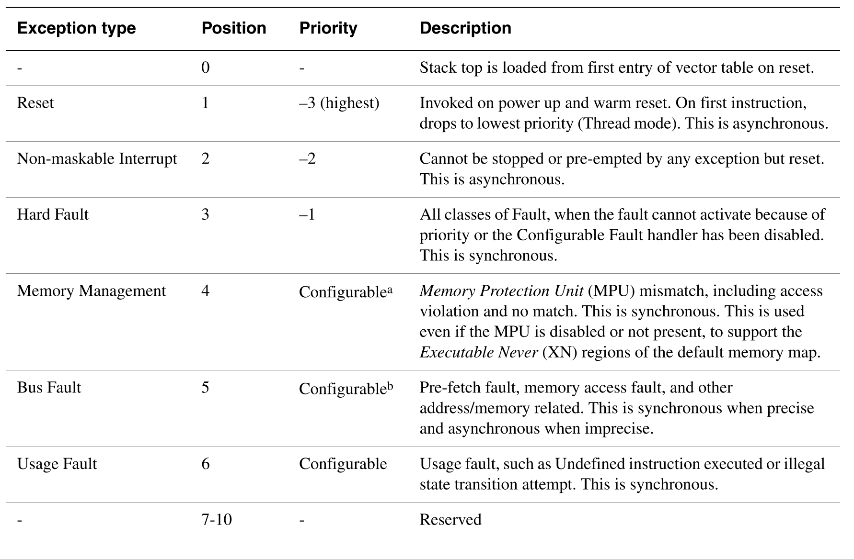
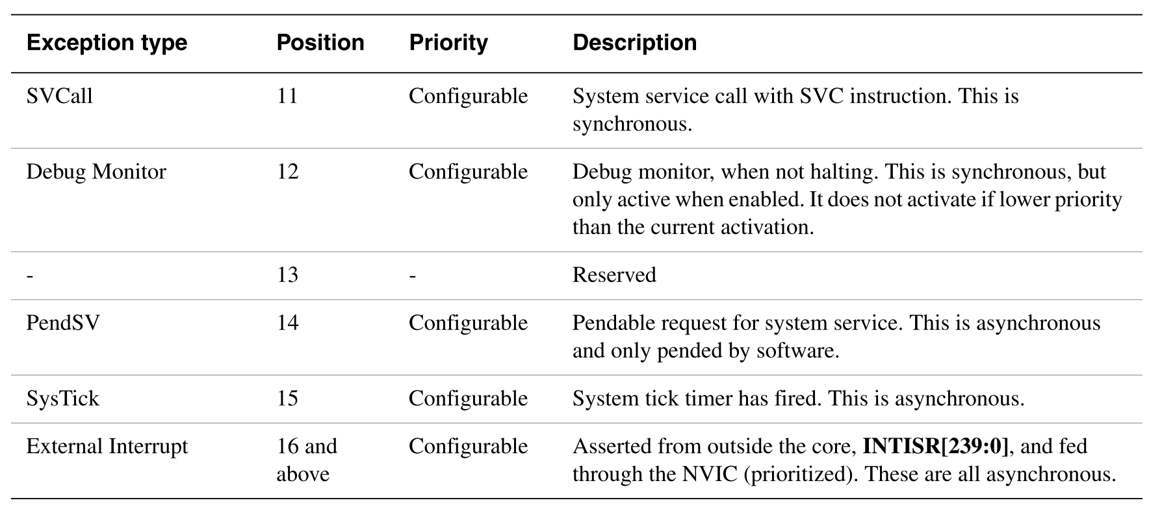
Exception(interrupt) types of Cortex-M3

Slide 19
Fault exception
Bus Fault
Error response, prefetch abort, data abort, .etc
Memory Management Fault
MPU, uCode stack push/pop error, MPU mismatch, etc.
Usage Fault
Undefined Instruction, Illegal unaligned load or store, etc.
Hard Fault
Vector Read error, Escalated to Hard Fault
Question: Signals of these fault exception == feedback of observer ?

Slide 20
Interfaces
Interrupt interface
INTNMI : Non-maskable interrupt
INTISR[239:0]: External interrupt
Question: Interrupt analysis ?
Ref: https://github.com/H4oK3/interrupt_analysis
Notes:
Nested Vectored Interrupt Controller （NVIC）
进入内核的方法有4种：
syscall 系统调用
exception 错误
外部中断
内核内部进程被执行

Slide 21
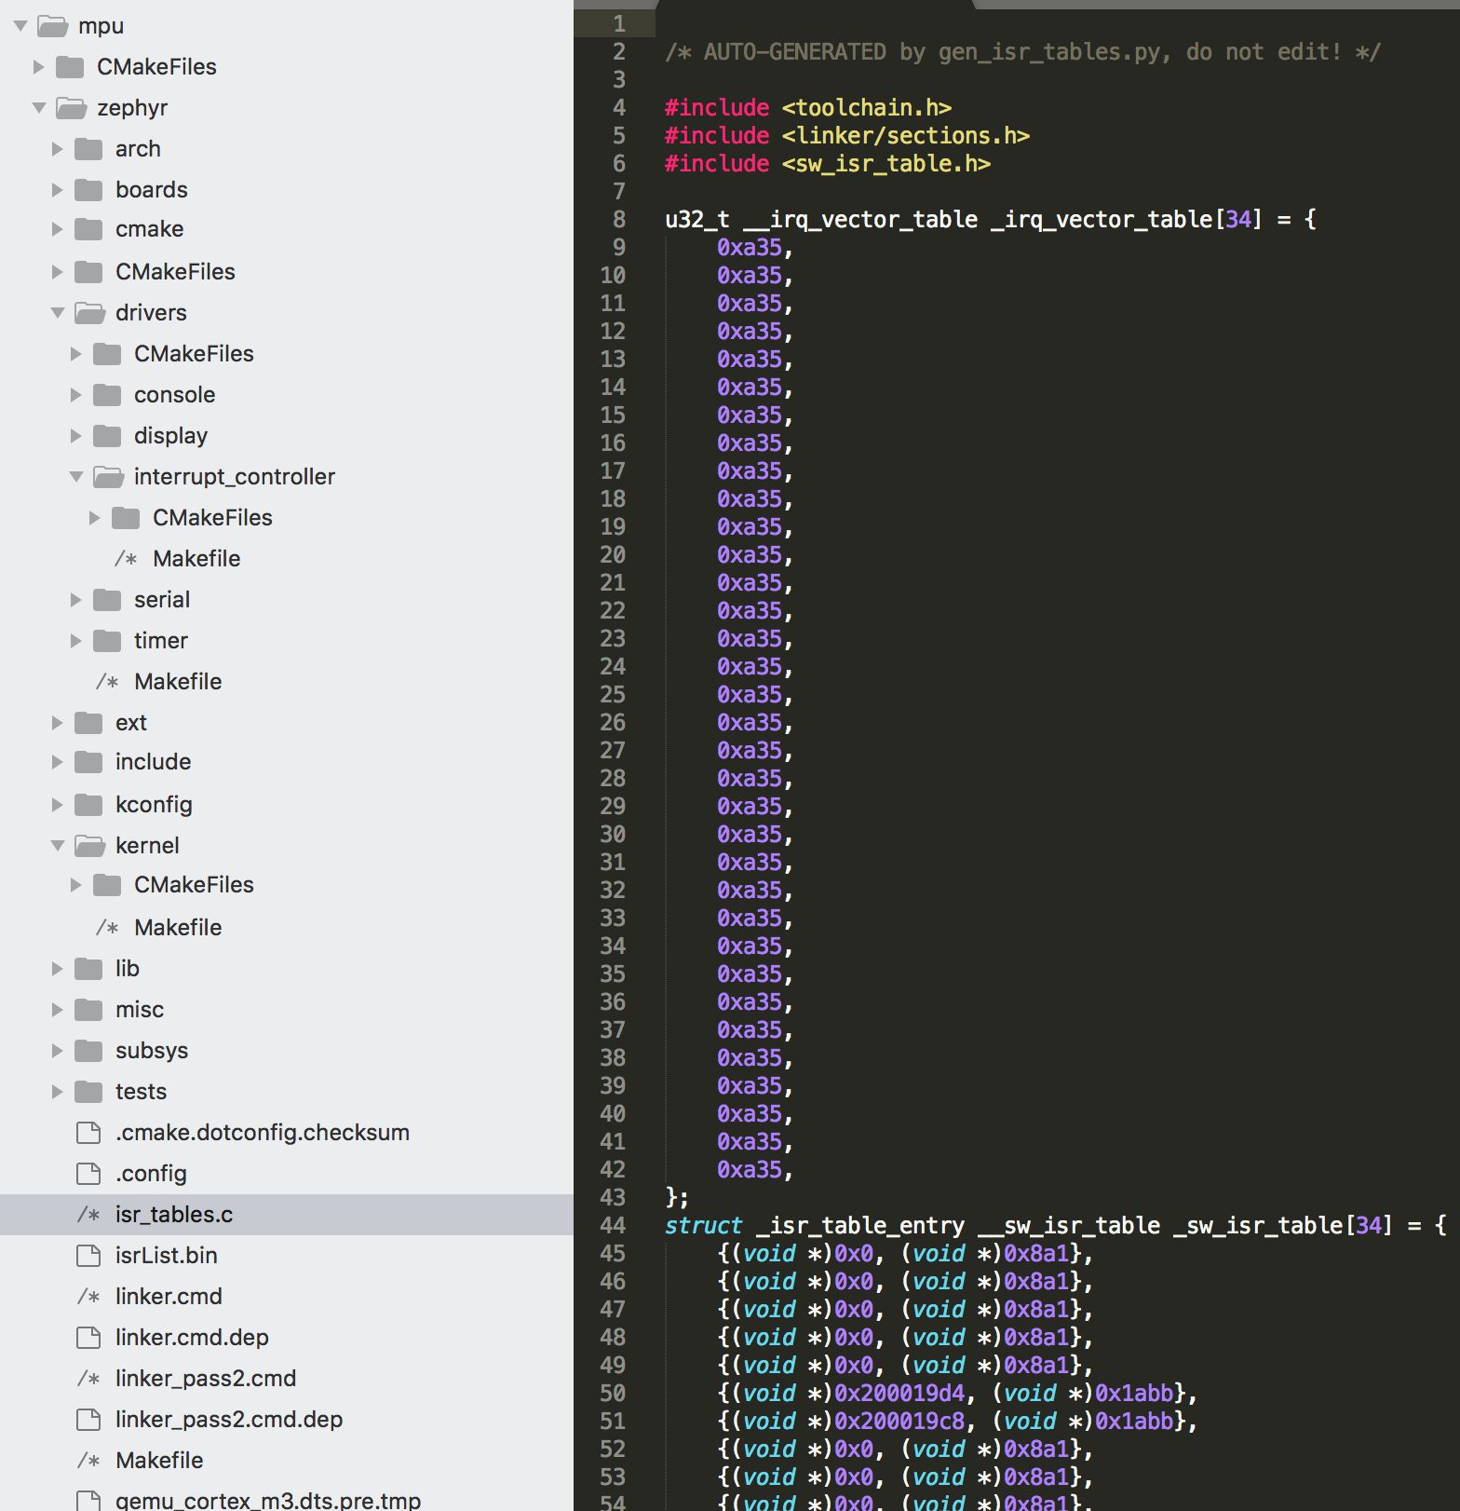
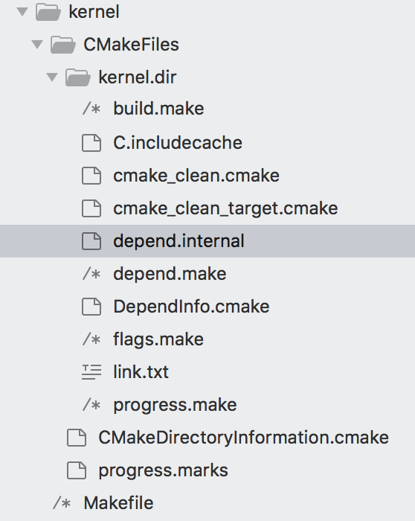
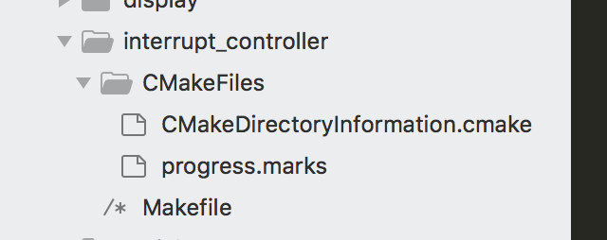
Specific firmware code-MPU_test
Notes:
Find the code related to the Nested Vectored Interrupt Controller, and write an agent to interact with it. I could input data to it, and perform different interrupt analysis.
Second, I need to test the actual signals of different fault signals.

Slide 22
Prof. Liu
Tiny virtual file system code are 500 lines.
The do not have virtual memory MM.c
Do not contain any driver code
System call: 49, all of them are inline functions, href
Multiple tasks, scheduler
No isolation, have notion of task, have no notion of process
Kernel space, one user space
Kernel stack
Two tasks: one user space, one kernel space
In the specific firmware, do not contain any driver
Need CPU, not need any peripheral

Slide 23
Prof. Liu
What to do to corrupt the kernel space ?
Figure out ways of exploiting the system calls (bad idea)
NDSS’18 does not have any higher privilege, our firmware has two privilege levels (zephyr mpu firmware)
Assume user space code is totally malicious, try ROP ?
Stack overflow is possible
Fuzzing goal: fuzz testing the user space interface
How to fuzz the gate ? 49 APIs for the gate
See code, complier code, run in qemu
Instrument code
Qemu plugin (two privileges, remember 3000 code)
Read file from the virtual file system, could not open file
Real case access file ? Need only buffer
Top1 microcontroller, factory, hard-coded log.c system, pre allocated buffer
Notes:
Try different directions when doing research, have more than 3 directions, do not follow the same one direction alwayls

Slide 24
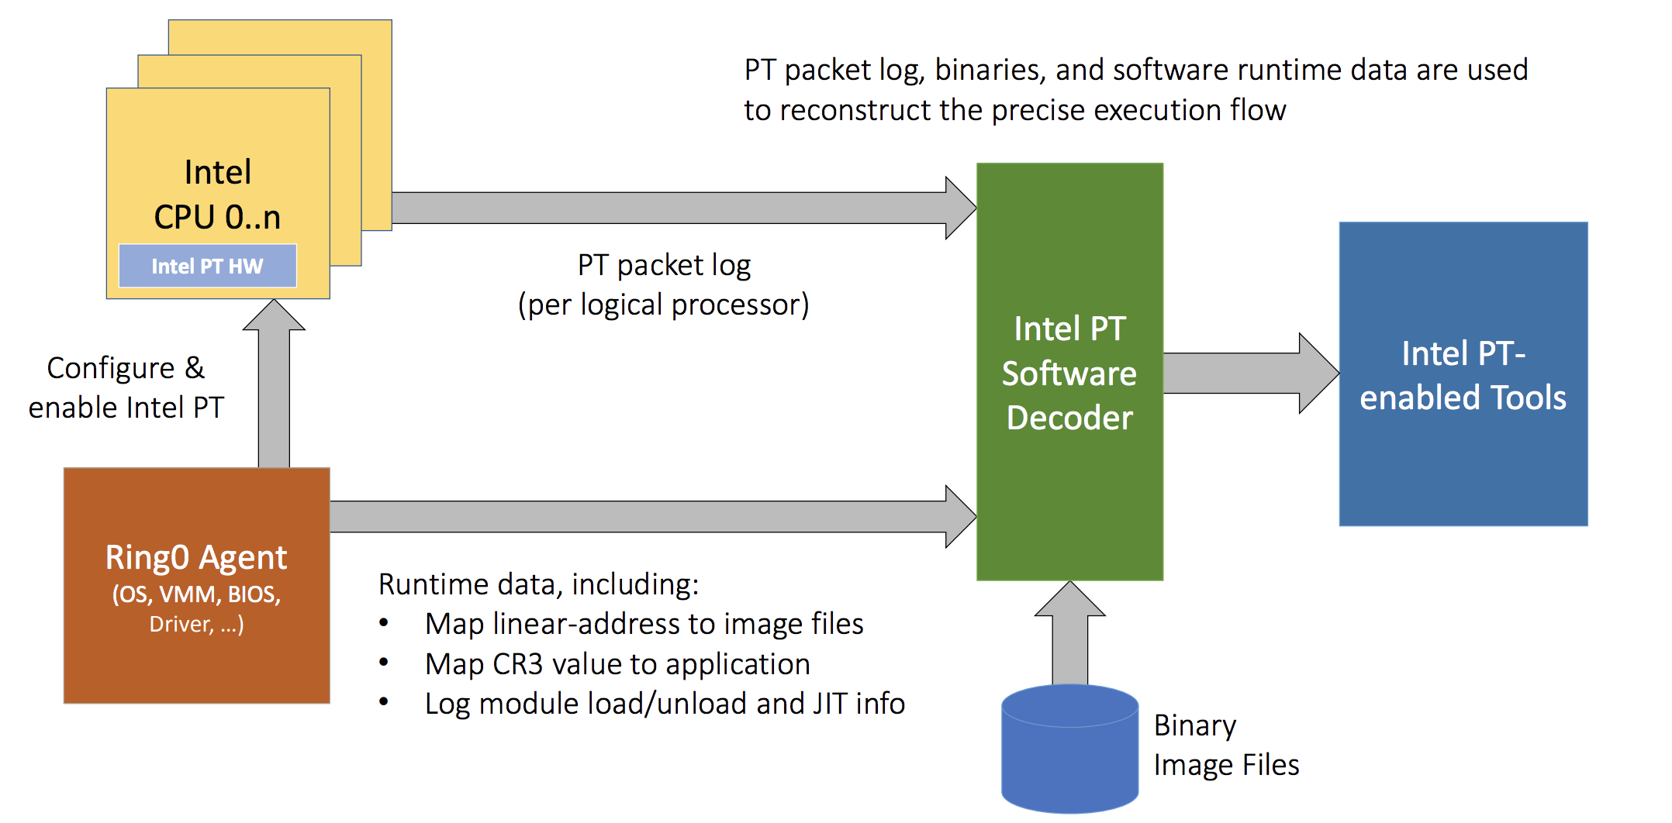
Intel-PT
https://software.intel.com/en-us/blogs/2013/09/18/processor-tracing
Notes:
Intel PT is a hardware feature that logs information about software execution

Slide 25
Progress of Appling kAFL to firmware
How to write the agent for different firmware ?
Unknown interface (base interrupt interface ? )
Prof.Liu : No, fuzzing the gate , based on the 49 APIs for the gate
How to handle silent memory corruption ?
Lack of MMU (fault exception signals)
Try a specific firmware with MPU
What’s the influence of non-x86 architecture of firmware ?
Qemu emulator (running firmware, specific supported firmware)
Hypercall still work (Yes)
KVM(only support emulating x86 on x86 host)
Intel-PT (can not track non-x86 traces, need translation and filtering)
Question: effective way to collect feedback ?
Notes:
If VM is running a non-x86 kernel, Intel-PT track the traces x86 instruments, and need to be translated to x86 instruments, and furthermore to be filtered,
I have no a direct cognition about this, I need to try the intel-PT.

Slide 26
Other dynamic analysis for ARM firmware
S2E
S²E runs unmodified x86, x86-64, or ARM software stacks, including programs, libraries, the kernel, and drivers.
http://s2e.systems/docs/
Angr
Python framework for analyzing binaries, including a symbolic execution tools
http://angr.io
Avata2 (based on S2E)
Target orchestration framework with focus on dynamic analysis of embedded devices' firmware
https://github.com/avatartwo/avatar2
Analyze Peripheral Interrupts for ARM embedded system
https://github.com/H4oK3/interrupt_analysis
Notes:
http://www.s3.eurecom.fr/tools/avatar/

Slide 27
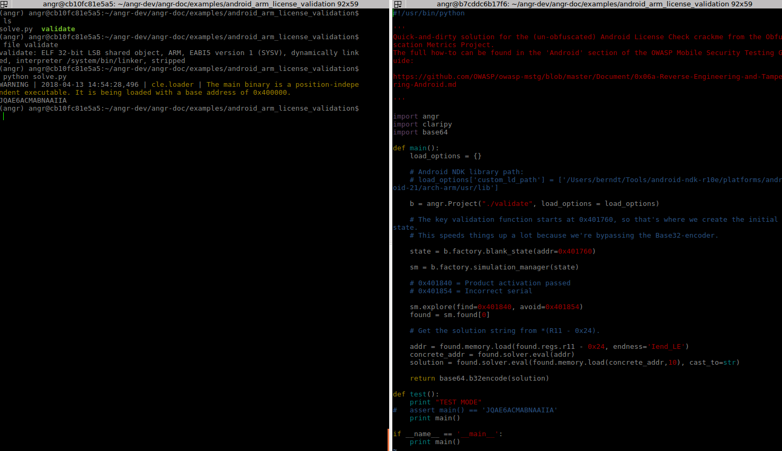
Example of Angr

Slide 28
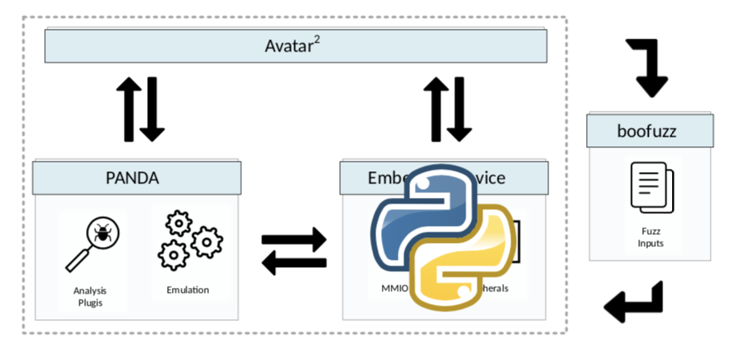
TODO Next
Mpu code, complier, run in qemu
Remember the 3000 code of mpu kernel
Instrument the firmware code, add plugin of qemu, and re-complier it and run it
Write an agent based on 49 APIs for gate
Additionally:
Angr: symbolic execution a specific firmware
Avata2: fuzzing a firmware kernel using interrupt agent

Slide 29
Firmware Kernel Fuzzing
Lingyun Situ
2018-04-20

Slide 30
Outline
Zephyr
Code and APIs
Sample application calling specific APIs
Interfaces for sample application
Console
argv
Network
Question

Slide 31
Zephyr
Zephyr OS is based on a small-footprint kernel designed and use on resource-constrained systems. Its kernel support: ARM Cortex-M, Intel x86, ARC, NIOS II, etc.
Features:
Single address-space, application and kernel code execute in shared address space.
Cross architecture, support various boards with different CPU architectures
Memory Protection, configurable architecture-specific stack-overflow protection, permission tracking, thread isolation on x86, arc, and arm
Native networking stack, LwM2M, Bluetooth
Github: https://github.com/zephyrproject-rtos/zephyr

Slide 32
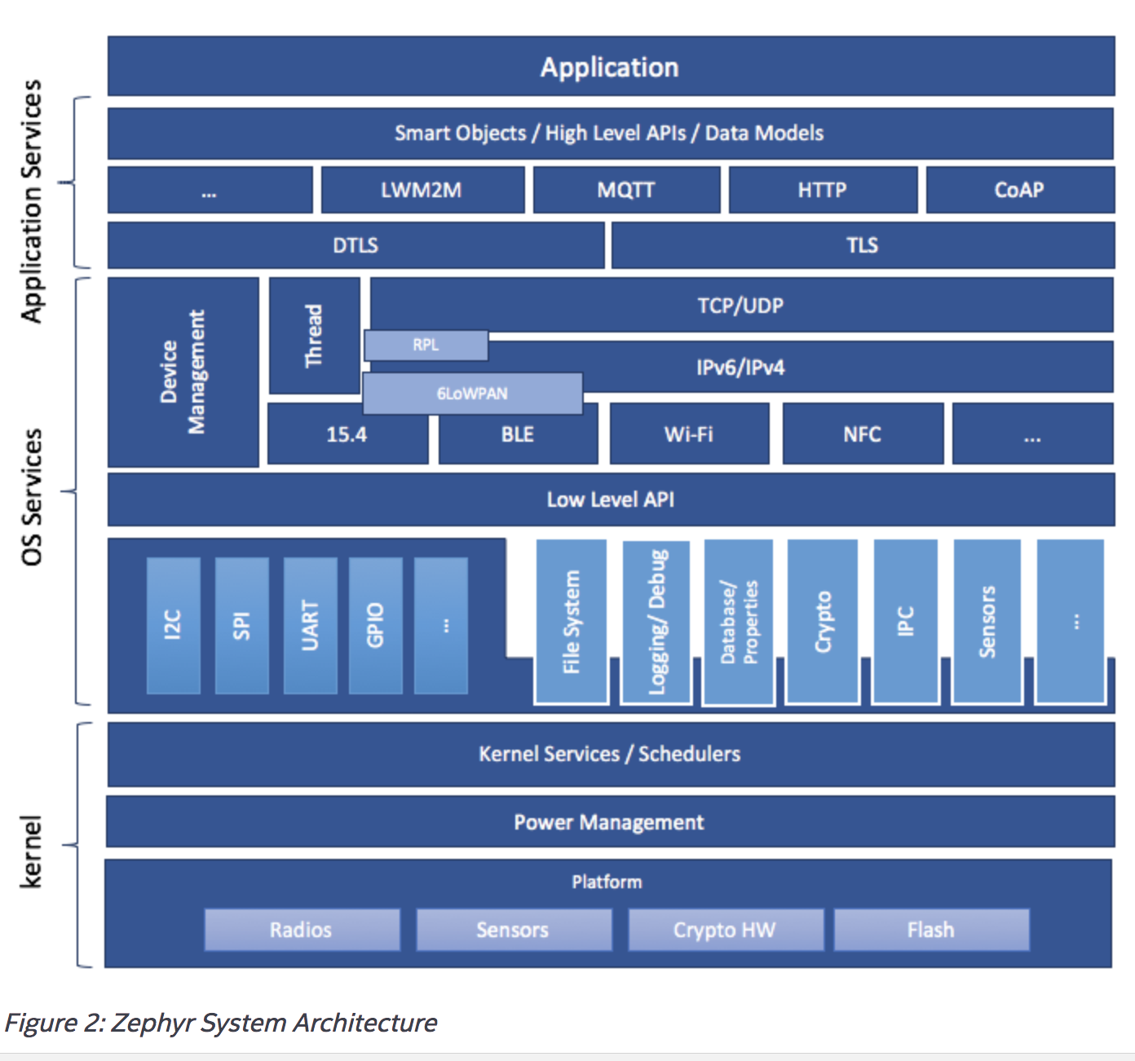
Zephyr architecture

Slide 33
Zephyr Source Tree Structure
Arch: Architecture-specific kernel and system-on-chip (SoC) code.
Boards: Board related code
Drivers : Device driver code.
Ext: Externally created code that has been integrated into Zephyr from other sources
Include: Include files for all public APIs, except those defined under lib
Kernel: Architecture-independent kernel code.
Lib: Library code, including the minimal standard C library.
Misc: Miscellaneous code that doesn’t belong to any of the other top-level directories.
Samples: Sample applications that demonstrate the use of Zephyr features.
Subsys: Subsystems of Zephyr, including: USB device stack code. Networking code, including the Bluetooth stack and networking stacks. File system code. Bluetooth host and controller
Tests: Test code and benchmarks for Zephyr features

Slide 34
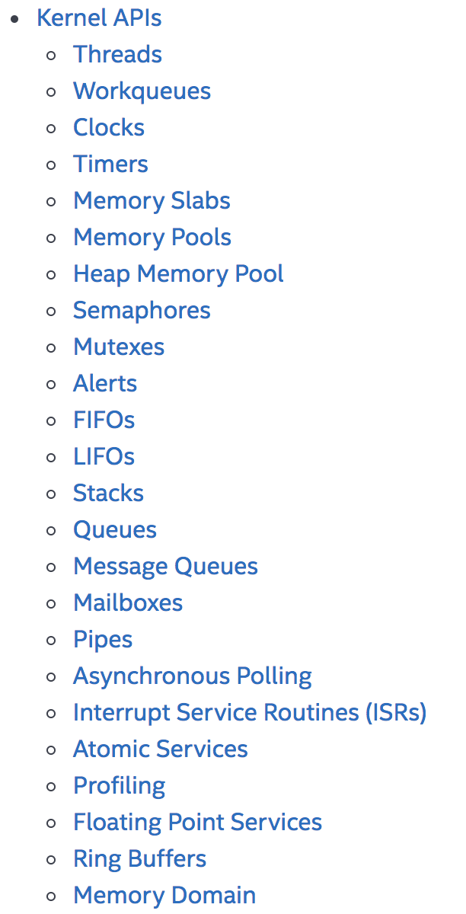
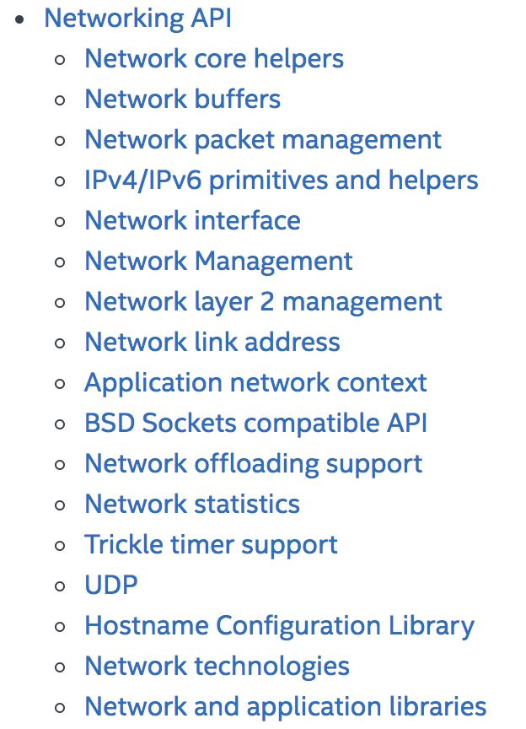
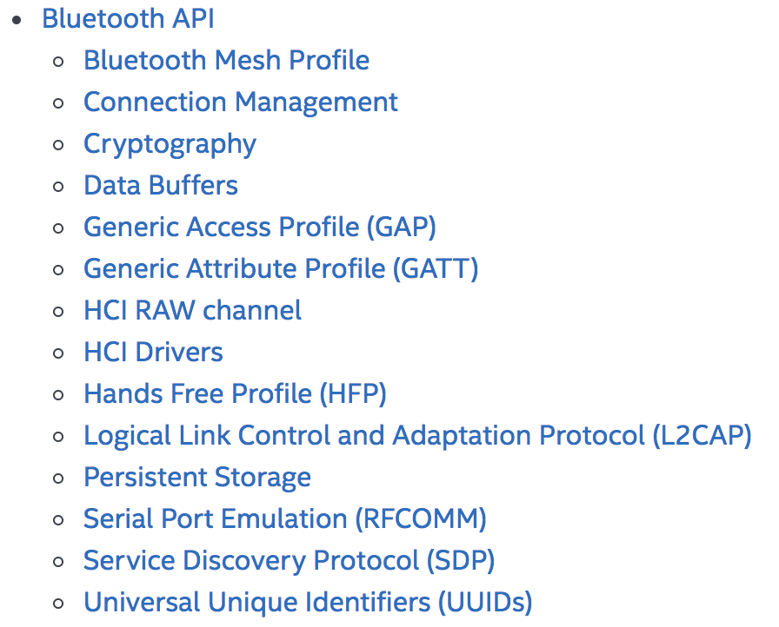
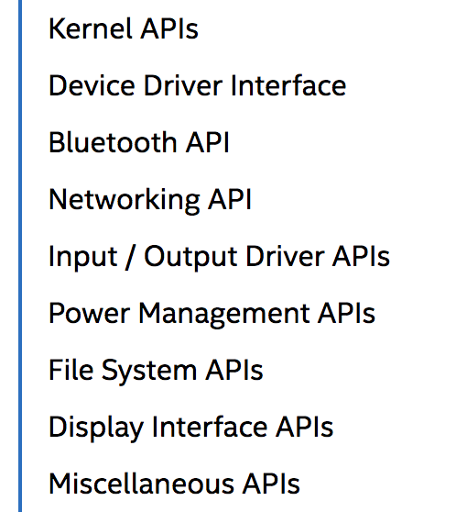
APIs

Slide 35
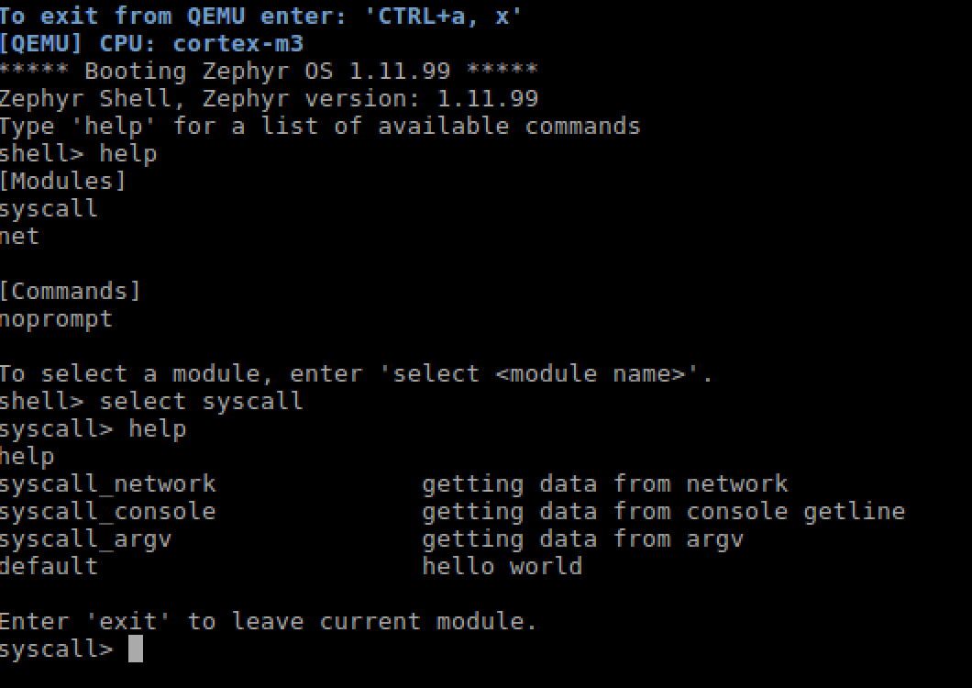
Sample application

Slide 36
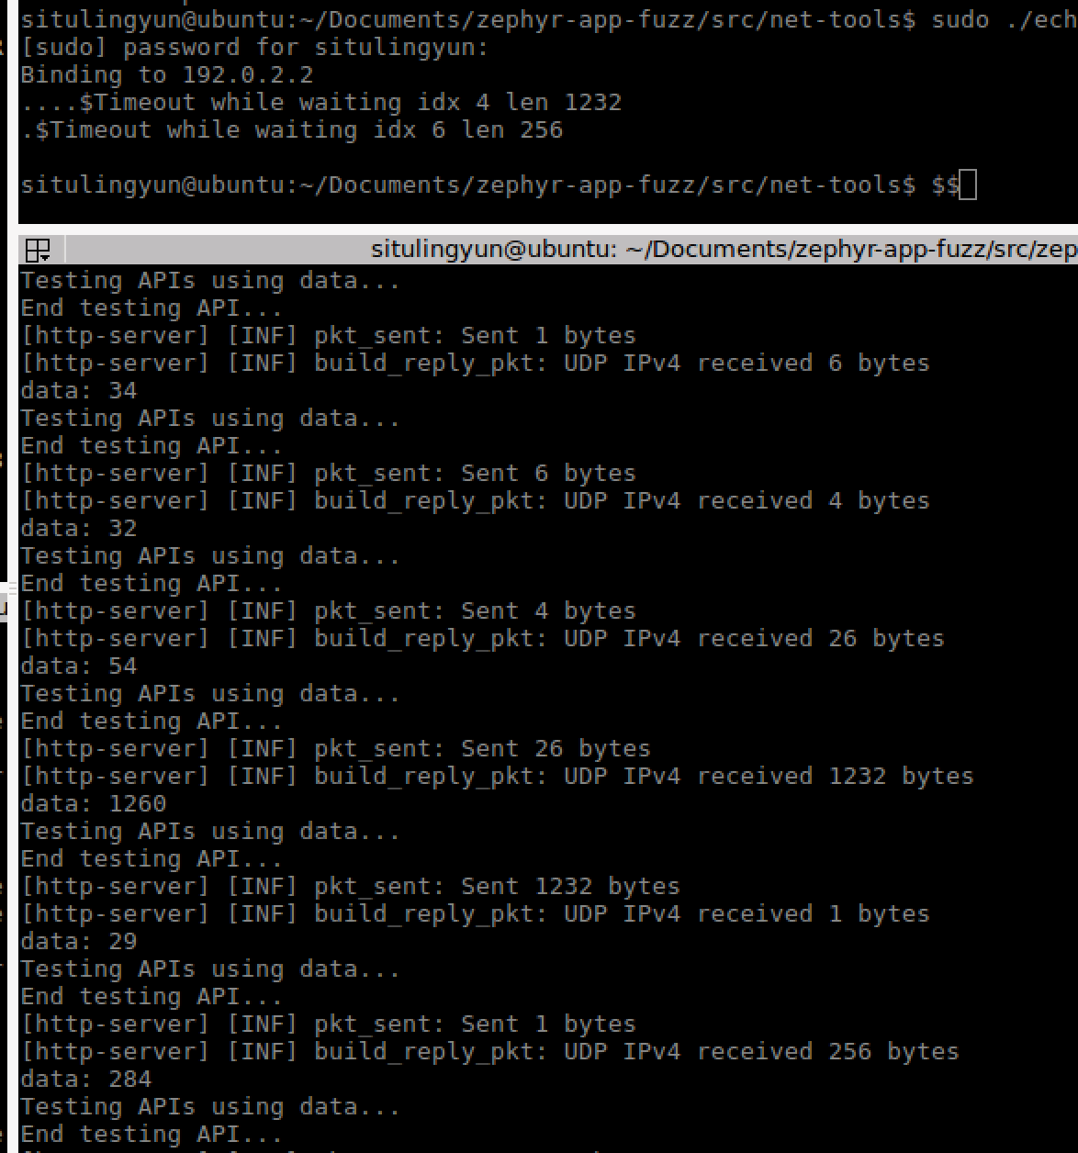
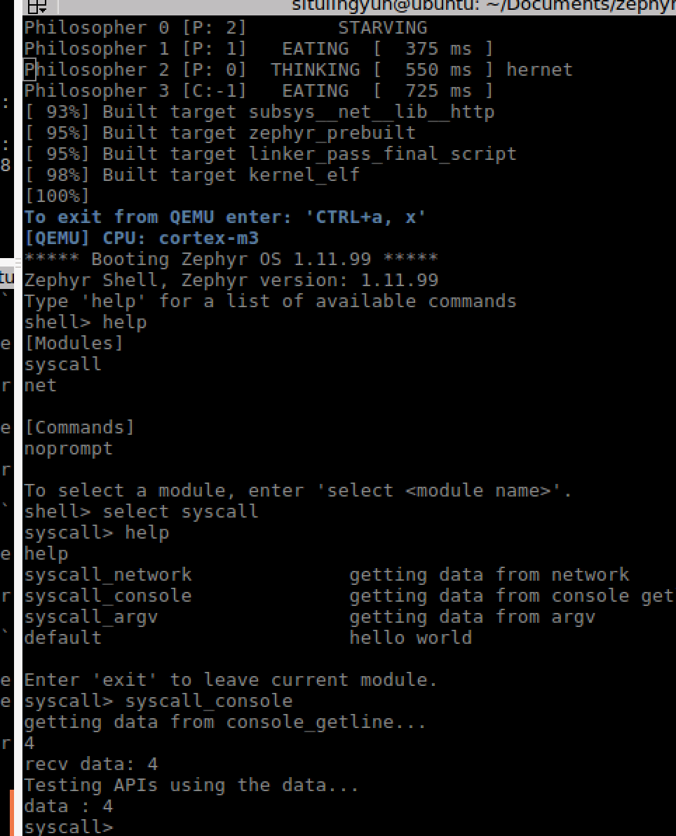
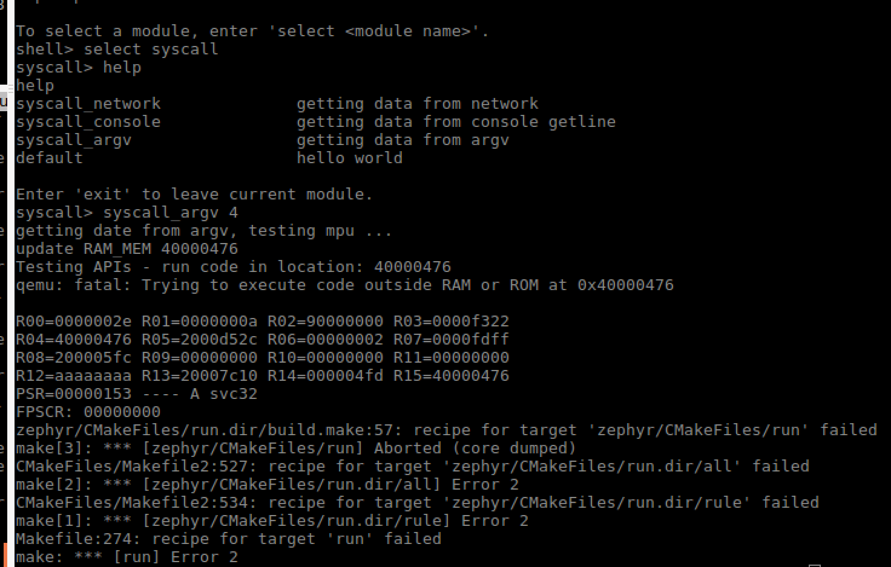
Interfaces for sample application
Network(tcp/udp, http)
console
argument

Slide 37
Question
Question: signals indicate kernel vulnerabilities.
No response from network interface any more. (Prof.Liu: No, not via network)
No qemu log any more. (Prof. Liu: writing a qemu plugin as observer.)
Applications call various APIs.
(Prof.Liu: first regard each API as independent)
Fuzzer, sending data to application outside of the qemu.
(Prof. Liu: not from outside, writing application as a fuzzer in qemu)
Prof.Liu: focus on becoming real expert in some new areas/aspects.

Slide 38
Firmware Kernel Fuzzing
Lingyun Situ
2018-04-26

Slide 39
Outline
Tool architecture
Fuzzer
Application (call kernel APIs)
Observer
Qemu plugin
Qemu tracing feature
Trace-Analyzer
Feedback
TODO

Slide 40
Tool architecture

Slide 41
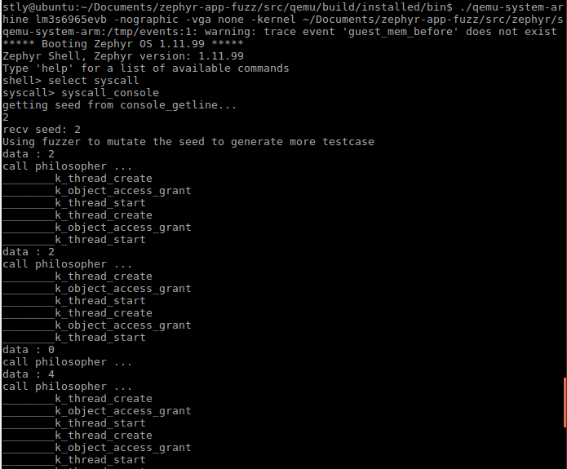
Fuzzer
Getting seeds
Mutator (random())
Feed to Application

Slide 42
Application
Kernel thread APIs
K_thread_create
K_object_access_grant
K_thread_start

Slide 43
Observer
Qemu plugin
There are already five plugins available by default:
icount : Count the number of executed *guest* instructions per CPU and produce a summary report each time CPUs are stopped
icount-inlined : Same as above but this plugin is *not* based on a helper, instead it inserts TCG opcodes inlined right at the beginning of each basic block
trace : Print the address/size/name of the current emulated basic block.
profile : Count the number of executed *guest* bytes/instructions per symbol and produce a profile report each time CPUs are stopped
dineroIV : Print the address/size/cpu of each loaded/stored data in a format supported by DineroIV, a highly configurable cache simulator
Run plugin
qemu-x86_64 –tcg-plugin ./tcg-plugin-trace.so (plugin name) /path/to/bin
qemu-x86_64 –tcg-plugin trace /path/to/bin
https://github.com/guillon/qemu-plugins

Slide 44
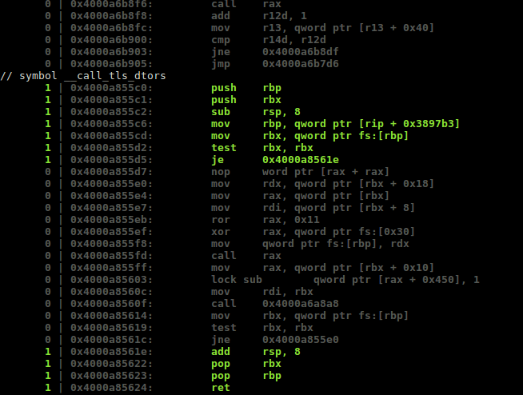
Qemu Plugin

Slide 45
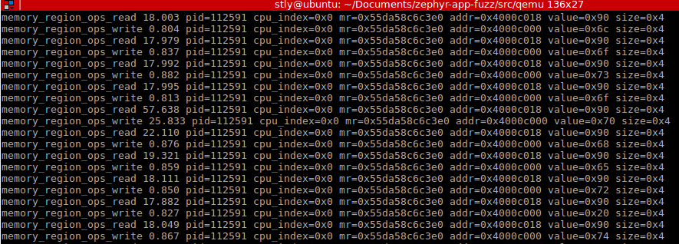
Qemu tracing
Qemu-backends-tracing
SystemTap
LTTng Userspace Tracer
Simple (built-in backend)
stderr
Simple, event=memory_region_ops_read/write
http://www.gorecursion.com/virtualization/2016/11/26/qemu-tracing1.html

Slide 46
Trace Analyzer
Simpletrace.py
A script used to analysis the traces to obtain useful information

Slide 47
FeedBack
Simpletrace.py
A script used to analysis the traces to obtain useful information
Inst Num
Branch
memOp num
…

Slide 48

Tool architecture
$$?$$
Is there any simple and efficient way to exchange data between Host and guest application ? Network, hypercall

Slide 49
Todo next
Judger
What kind of observer ( what event should be added into tracer) ?
How to explain the traces and turn them into effective feedback ?
What kinds of observation -> what kinds of mutators ?
What kinds of observation -> vulnerabilities ?

Slide 50
Firmware Kernel Fuzzing
Lingyun Situ
2018-05-25

Slide 51
Outline
Existing kernel fuzzing tools
List of RTOS
Existing firmware fuzzing
Our design and possible contribution
Tasks

Slide 52
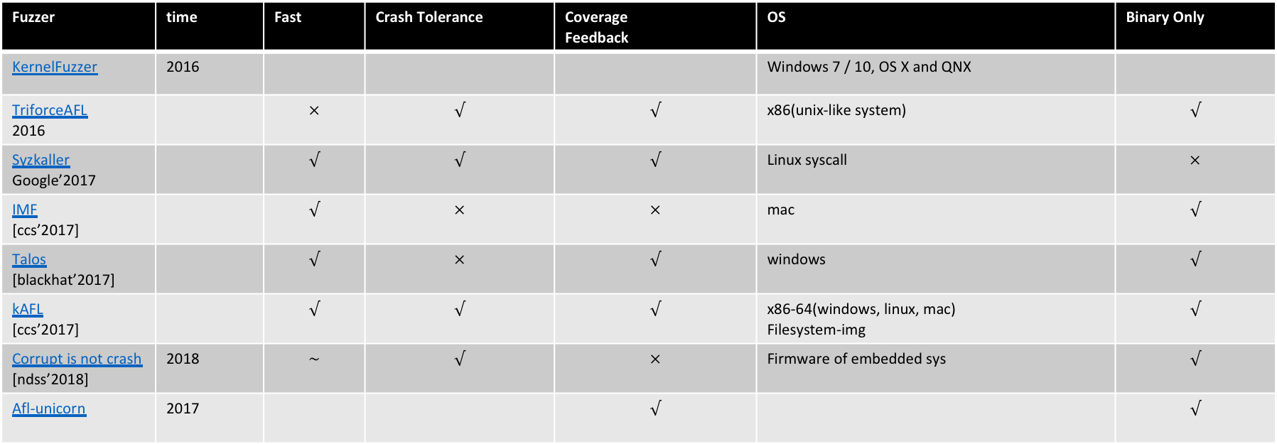
Existing kernel fuzzing tools
Fuzzer | time | Fast | Crash Tolerance | Coverage Feedback | OS | Binary Only
KernelFuzzer | 2016 |  |  |  | Windows 7 / 10, OS X and QNX
TriforceAFL 2016 |  | $$×$$ | $$√$$ | $$√$$ | x86(unix-like system) | $$√$$
Syzkaller Google’2017 |  | $$√$$ | $$√$$ | $$√$$ | Linux syscall | $$×$$
IMF [ccs’2017] |  | $$√$$ | $$×$$ | $$×$$ | mac | $$√$$
Talos [blackhat’2017] |  | $$√$$ | $$×$$ | $$√$$ | windows | $$√$$
kAFL [ccs’2017] |  | $$√$$ | $$√$$ | $$√$$ | x86-64(windows, linux, mac) Filesystem-img | $$√$$
Corrupt is not crash [ndss’2018] | 2018 | $$\sim$$ | $$√$$ | $$×$$ | Firmware of embedded sys | $$√$$
Afl-unicorn | 2017 |  |  | $$√$$ |  | $$√$$

Slide 53
List of RTOS
https://en.wikipedia.org/wiki/Comparison_of_real-time_operating_systems
VxWorks
XP Embedded
Windows CE
DSP/BIOS
FreeRTOS

Slide 54
Existing firmware fuzzing
Corrupt is not crash. (no feedback, user level)
Notes:
Afl-unicorn

Slide 55
Our design
Sample: zephyr RTOS
Apply afl to zephyr kernel (with feedback, kernel level)
Contribution(maybe):
Bug discovery of zephyr RTOS
A general fuzzing tool for RTOS similar to Zephyr
Root cause analysis of typical vulnerability of zephyr RTOS

Slide 56
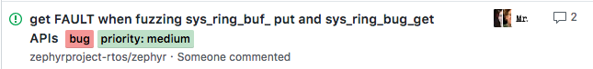
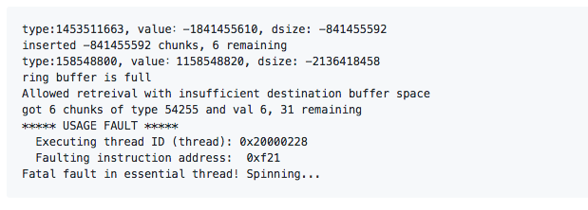
1. Brute force fuzzing Zephyr APIs
Example:
https://github.com/zephyrproject-rtos/zephyr/issues/7638
https://github.com/zephyrproject-rtos/zephyr/issues

Slide 57
2. development of fuzzing tool

Slide 58
Tasks
1. Brute force fuzzing Zephyr APIs (>193) (on-going)
https://docs.google.com/spreadsheets/d/14kdBNgf-GBGBZ6tyvsNqeQLAPgvoBSAFR-TqK26BQg4/edit#gid=0
2. Tool development
Application call APIs, which receive data by network interface (done)
Panda Plugin to collect the traces and extracted useful feedback
AFL mutate data based on feedback and send data to Application
3. Root cause analysis of detected bugs (on-going)

